Slide 1


RESUME BUILDING SYSTEM
PROJECT UNDER SUPERVISION OF
PROF. KEERTI KHARATMOL

Slide 2

GROUP MEMBERS
▶ B-03 . SANKET PARULEKAR
▶ B-04 . PATEL NAWAZISH
▶ B-05 .ANURAG PATIL

Slide 3
INDEX
INTRODUCTION
PROBLEM STATEMENT
AIM
OBJECTIVES
LITERATURE SURVEY
SOFTWARE REQUIREMENTS
METHODOLOGY(FLOWCHARTS)
CONCLUSION
REFRENCES

Slide 4
INTRODUCTION
The Mini-Project Resume Building System is a user-friendly software tool designed to assist individuals in creating professional and effective resumes.
This system streamlines the resume-building process by offering templates and guidance, allowing users to input their relevant information and work experiences, and then automatically generating a polished and well-organized resume.
It aims to simplify the often daunting task of resume creation, helping users present their qualifications and skills in a compelling way to potential employers.
Whether you're a recent graduate, a career changer, or someone looking to update your existing resume, the Mini-Project Resume Building System can help you craft a standout document for your job search needs.

Slide 5
PROBLEM STATEMENT
Many individuals struggle to create professional and effective resumes, often resulting in poorly organized and unimpressive documents. How can we develop a system that streamlines the resume-building process to save time and produce high-quality resumes?
Generic resume templates may not allow users to customize their resumes according to specific job requirements or industries. How can we provide a level of customization that tailors resumes for different job applications?
How can we assess the effectiveness of our resume building system in terms of user satisfaction, employment outcomes, and the quality of generated resumes?

Slide 6
AIM
The aimof building a resume building system is to createa user-friendly toolthat implifies the resume creationprocess.It shouldallowcustomization,maintain professionalformatting,provideuserguidance,ensuredatasecurity,adapttochanging trends,integratewithjobplatforms,offerfeedback,andmeasureitseffectiveness.

Slide 7
OBJECTIVES
Project Objectives:-
To design and develop a user-friendly and efficient Resume Building System that empowers individuals to create professional, tailored resumes effortlessly, helping them stand out in the competitive job market.

Slide 8
LITERATURE SURVEY
▶ General review :-
The development of online resume builder systems commenced several years
ago.
During that era, there was a noticeable absence of comprehensive management systems capable of efficiently organizing task in alignment with the increasing demand for professional resumes.
Numerous researchers entered the domain with the aim of introducing advanced systems to address the needs of a growing population seeking effective tools for crafting resumes, but initial efforts proved to be challenging.

Slide 9
Software Requirements
Web technologies:- HTML-5, CSS-3, Javascript with Vanilla JS library.
Tools used :- Notepad and Basic Chrome Browser of any Device.

Slide 10
METHODOLOGY
(Flowcharts of different partsof
system)

Slide 11
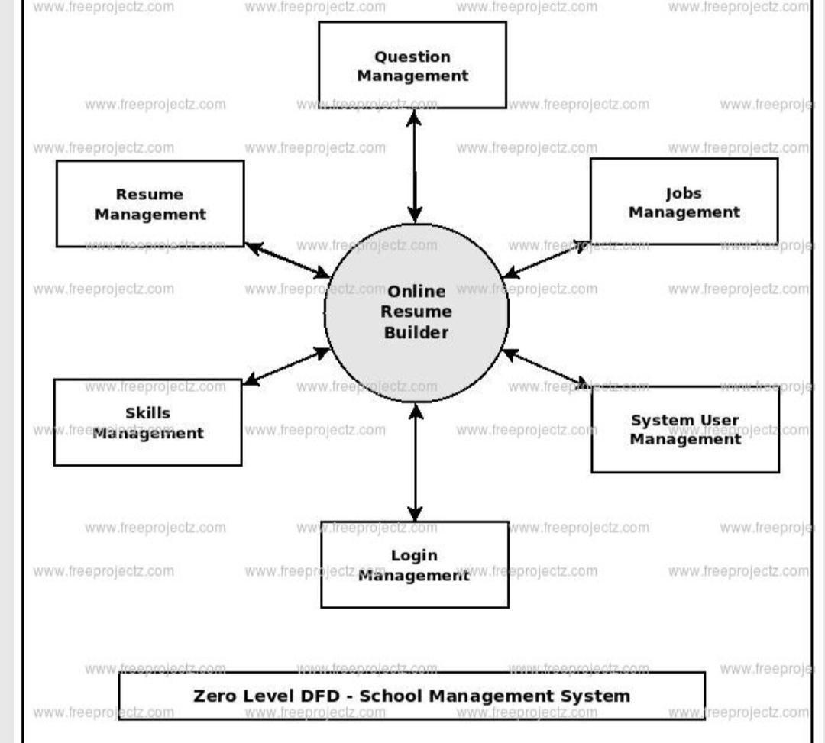
DFD LEVEL-0

Slide 12
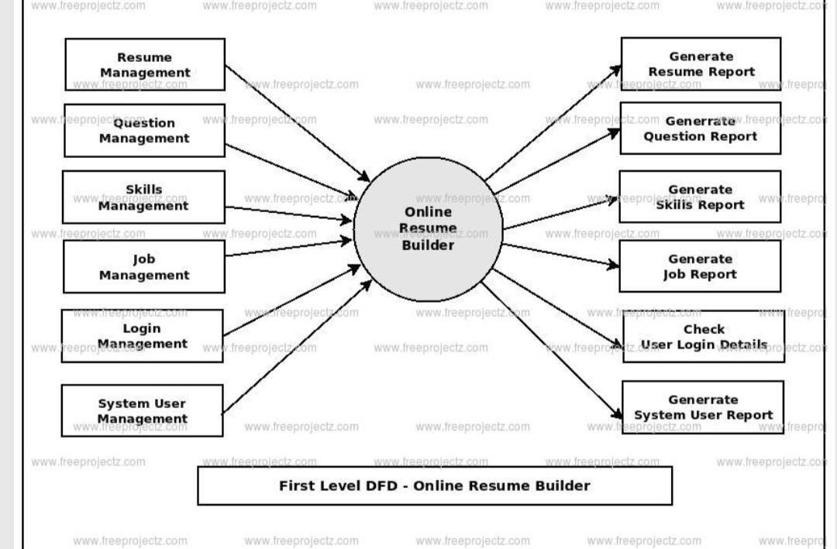
DFD LEVEL-1

Slide 13
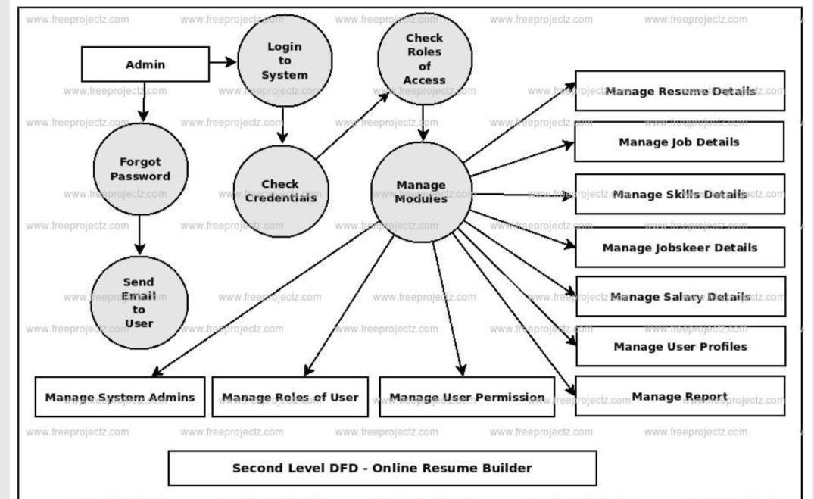
DFD LEVEL-2

Slide 14
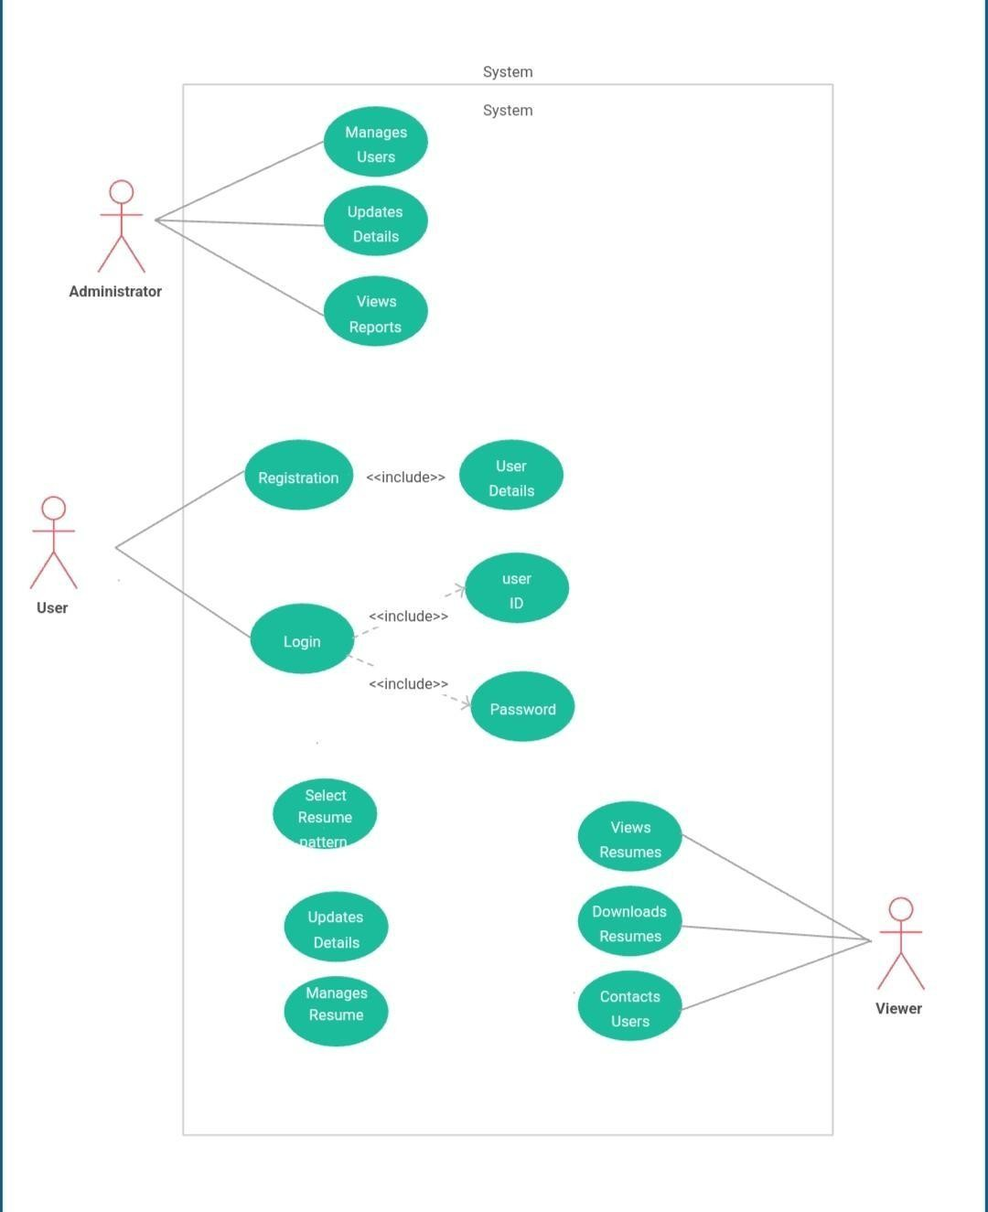
USECASE DIAGRAM

Slide 15
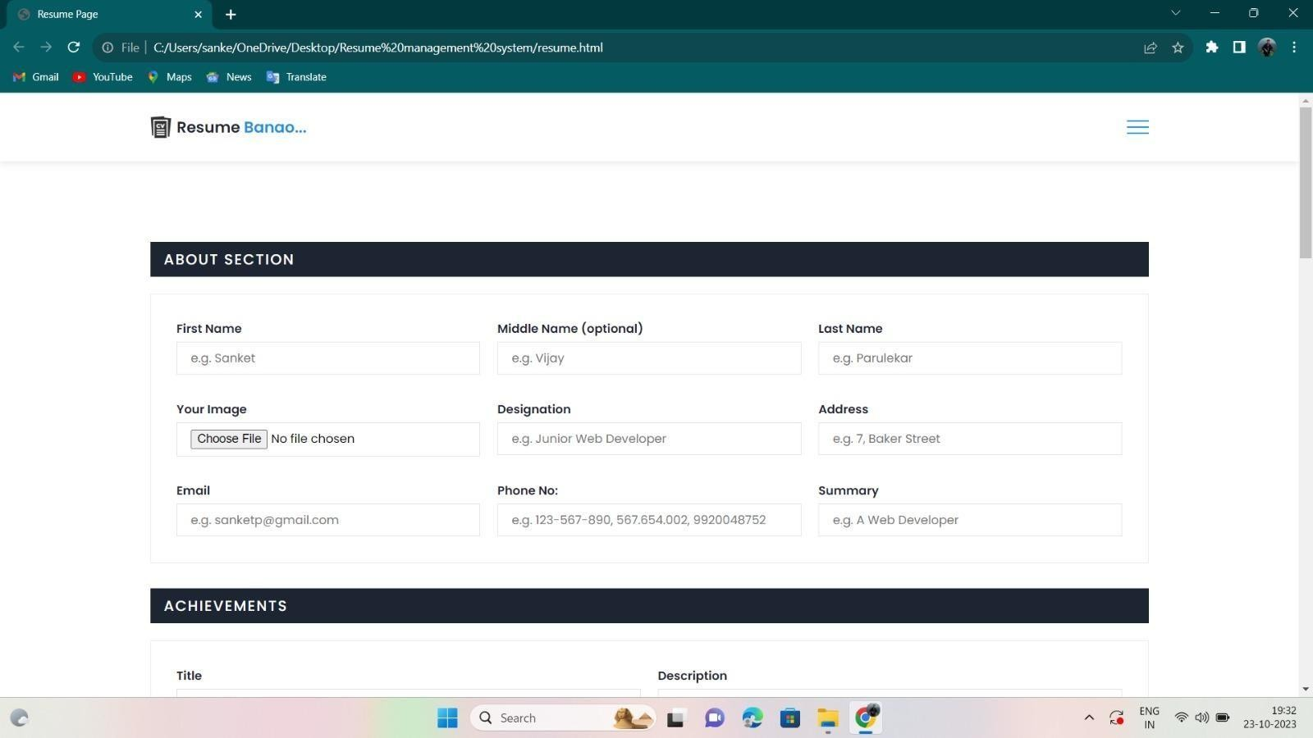
SITE DIAGRAM

Slide 16
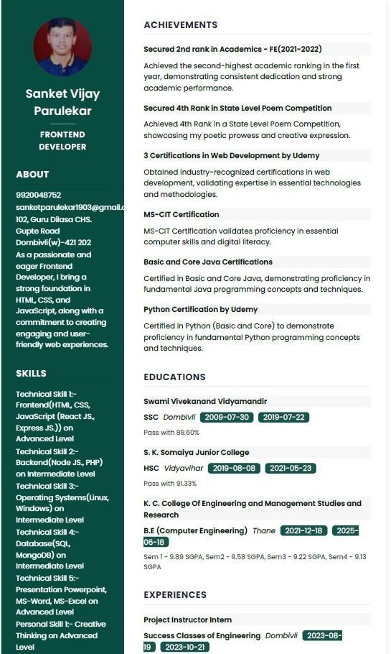
OUTPUT

Slide 17
Feedback
Feedback
Reviews
& suggestions
Photos,Videos

Slide 18
Conclusion
In conclusion, the Resume Building Project represents a valuable tool for individuals striving to make a strong impression in the competitive job market. By providing an intuitive, user-friendly platform, we have empowered users to effortlessly craft tailored resumes, showcasing their skills and experiences effectively.
This project not only streamlines the resume creation process but also serves as a testament to the power of technology in helping individuals achieve their professional aspirations.

Slide 19
REFRENC ES
https://images.app.goo.gl/ptysj8VGod1MtLad8
https://www.freeprojectz.com/dfd/online-resume-builder-dataflow-diagram

Slide 20


